Slide 2
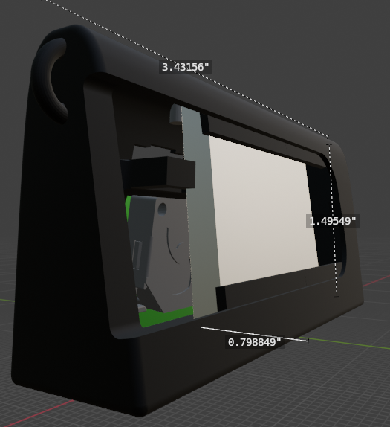
Valve 1
Fan 1
High-capacity Battery
PCB (Arduino Nano)

Slide 3
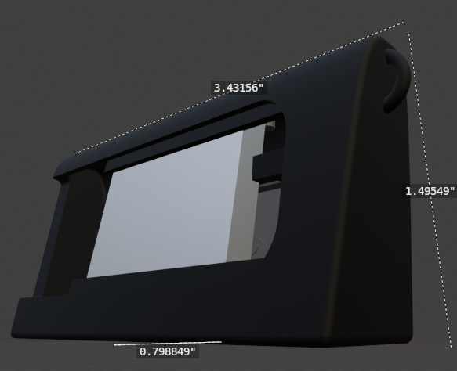
Valve 2
Fan 2

